Slide 1
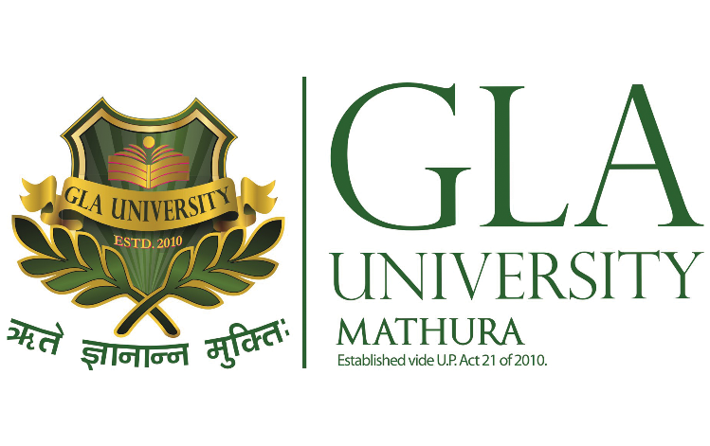
Introduction to Big Data Analytics (BCSE0157)
Credit Unit: 03
Dr. Robin Singh Bhadoria,
Asst. Professor, Dept. of CEA

Slide 2
Books & Important Links
Text Book: Seema Acharya and Subhashini Chellappan, “Big Data and Analytics”, 1st Edition, 2015, Wiley, India.
Links:
W3Schools
(https://www.w3schools.in/hadoop-tutorial/what-is-big-data/)
Tutorial Points (https://www.tutorialspoint.com/big_data_analytics/index.htm)

Slide 3
What is Big Data ?
“Big data is a term applied to data sets whose size or type is beyond the ability of traditional relational databases to capture, manage and process the data with low latency.”…..IBM Corporation
“Big data is the term for a collection of data sets so large and complex that it becomes difficult to process using on-hand database management tools or traditional data processing applications.”…..Wikipedia

Slide 4

Concept & Evolution of Big Data
The term big data has been in use since the 1990s, with some giving credit to Dr. John Mashey from Pennsylvania State University, USA. for popularizing the term.
Around 2005, people began to realize just how much data, users generated through Facebook, YouTube, and other online services.
Hadoop (an open-source framework created specifically to store and analyze big data sets) was developed that same year. NoSQL also began to gain popularity during this time.

Slide 5
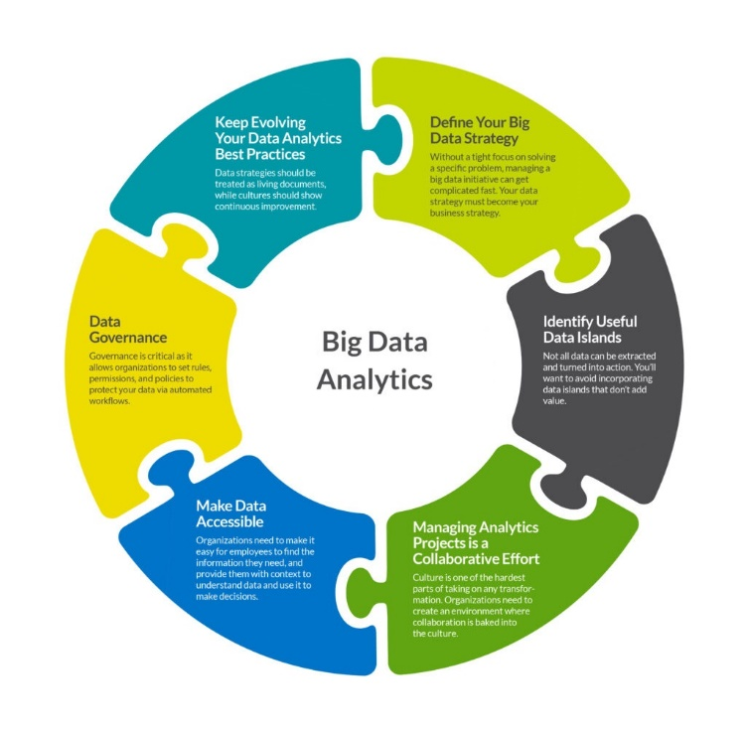

Slide 6
Types of Digital Data
There are three types of digital data.
1) Structured Data:- It has been organized into specific format that is typically database. e.g. Relational database.
2) Un-Structured Data:- Un-structured data is data which is not organized in specific manner or format. e.g. Audio, Video, PDF, Media
3) Semi-Structured Data:- It does not stored in relational database but that have some organizational properties. e.g. XML data, Emails.

Slide 7
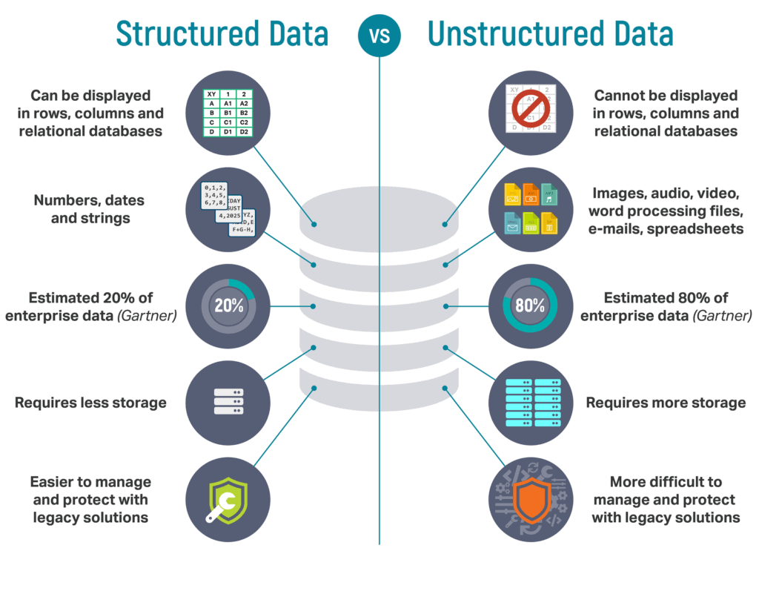

Slide 8
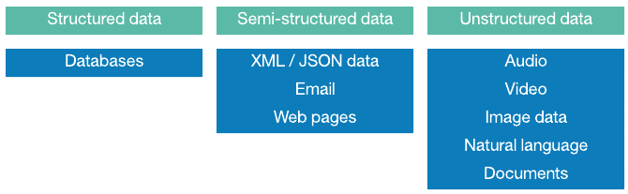
Examples

Slide 9
Importance of Big Data
Reduction in cost.
Time reductions.
Well-groomed decision making.
Real-time determination of core causes of failures, problems, or faults.
Risk-management can be done in minutes by calculating risk portfolios.

Slide 10
Big Data Analytics
Big Data analytics is a process used to extract meaningful insights, such as hidden patterns, unknown correlations, market trends, and customer preferences.
Benefits:
Risk Management
Product Development and Innovations
Quicker and Better Decision Making Within Organizations
Improve Customer Experience

Slide 11
Characteristics of Big Data: 5V’s
The primary characteristics of Big Data are:
Volume
Velocity
Variety
Veracity
Value

Slide 12
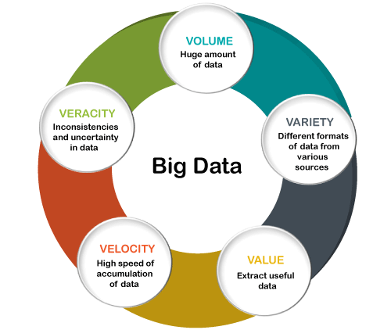

Slide 13
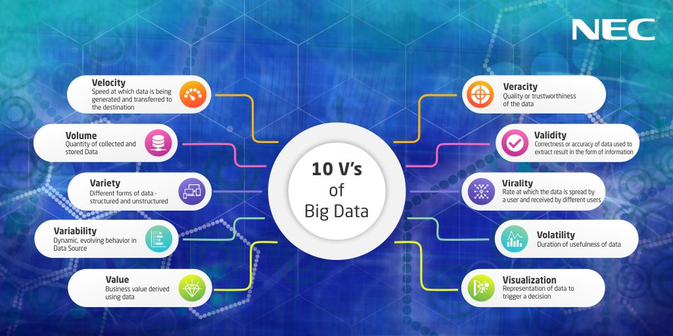
10V’s of Big Data

Slide 14
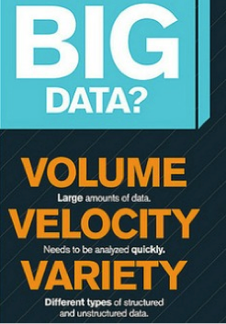

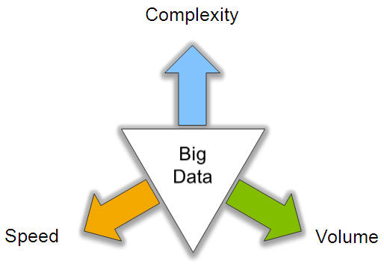
Characteristics of Big Data

Slide 15
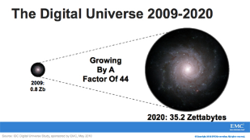
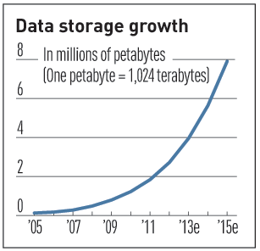

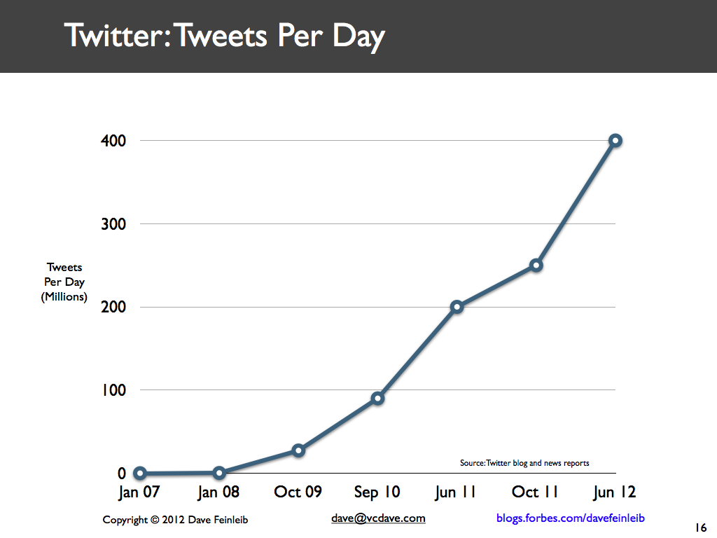
Volume (Scale)
Data Volume
44x increase from 2009 2020
From 0.8 zettabytes to 35zb
Data volume is increasing exponentially
Exponential increase in collected/generated data

Slide 16
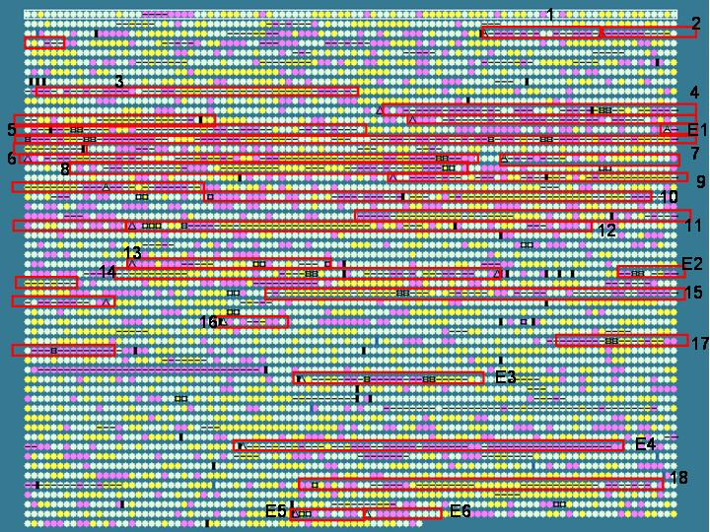
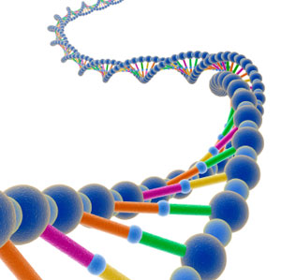
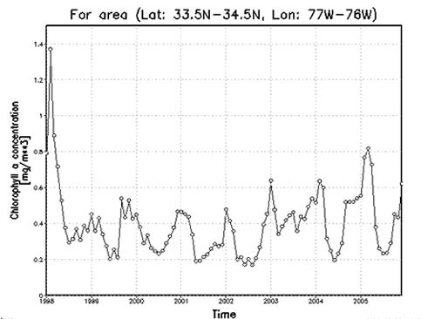

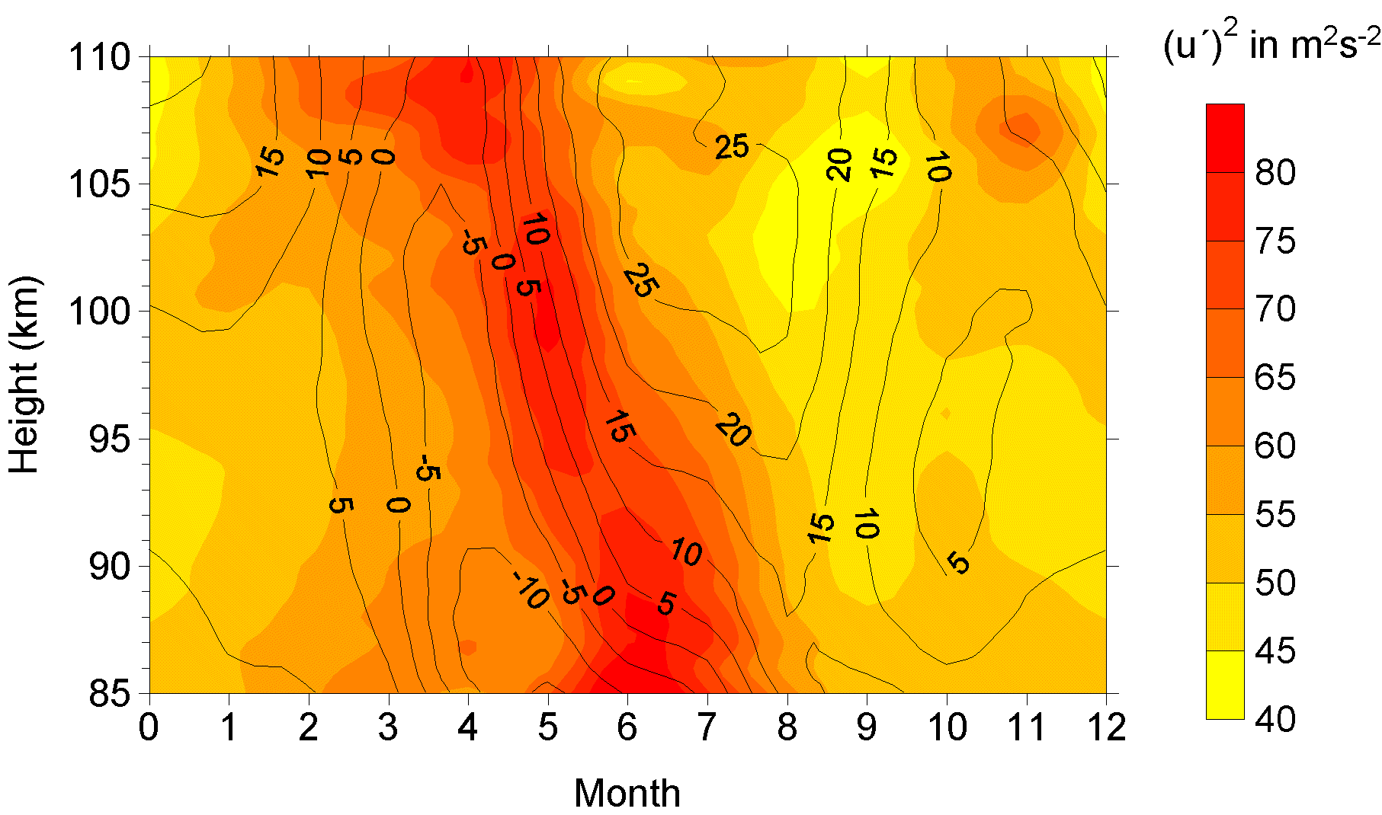

Variety (Complexity)
Relational Data (Tables/Transaction/Legacy Data)
Text Data (Web)
Semi-structured Data (XML)
Graph Data
Social Network, Semantic Web (RDF), …
Streaming Data
You can only scan the data once
A single application can be generating/collecting many types of data
Big Public Data (online, weather, finance, etc)

Slide 17

Velocity (Speed)
Data is begin generated fast and need to be processed fast
Online Data Analytics
Late decisions ➔ missing opportunities
Examples
E-Promotions: Based on your current location, your purchase history, what you like ➔ send promotions right now for store next to you
Healthcare monitoring: sensors monitoring your activities and body ➔ any abnormal measurements require immediate reaction

Slide 18
Challenges of Big Data
Rapid Data Growth: The growth velocity at such a high rate creates a problem to look for insights using it.
Storage: The generation of such a massive amount of data without suitable tools and technologies.
Unreliable Data: Redundant data, contradicting data, or incomplete data.
Data Security: Leads to cybercrimes and risk of data stolen.

Slide 19
Sources of Big Data
Three primary sources of Big Data:-
Social data: comes from the Likes, Tweets & Retweets, Video/Audio Uploads, via the world’s popular social media platforms.
Machine data: created as information which is generated by industrial equipment, sensors like medical devices, smart meters, road cameras, satellites, games etc..
Transactional data: generated from all the daily transactions that take place both online and offline. Invoices, payment orders, storage records, delivery receipts.

Slide 20
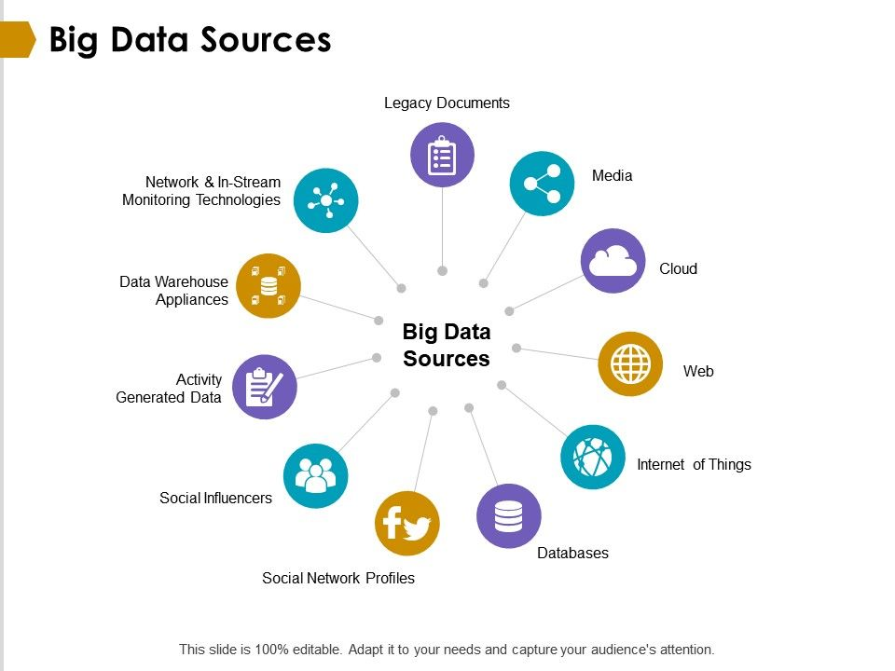

Slide 21
How to deal with Un-structured data ?
Today’s 80% of data in enterprise considered as un-structured data.
There can be following techniques:
Data Mining
Natural Language Processing (NLP)
Text Analysis
Noisy text Analysis

Slide 22
Different Types of Big Data Analytics
There are FOUR type of Big Data Analytics:
Descriptive Analytics:-This summarizes past data into a form that people can easily read. This helps in creating reports, like a company’s revenue, profit, sales, and so on.
Predictive Analytics:- This type of analytics looks into the historical and present data to make predictions of the future.
Prescriptive Analytics:-This type of analytics prescribes the solution to a particular problem. Perspective analytics works with both descriptive and predictive analytics.
Diagnostic Analytics:-This is done to understand what caused a problem in the first place. Techniques like drill-down, data mining, and data recovery are examples of this type.

Slide 23
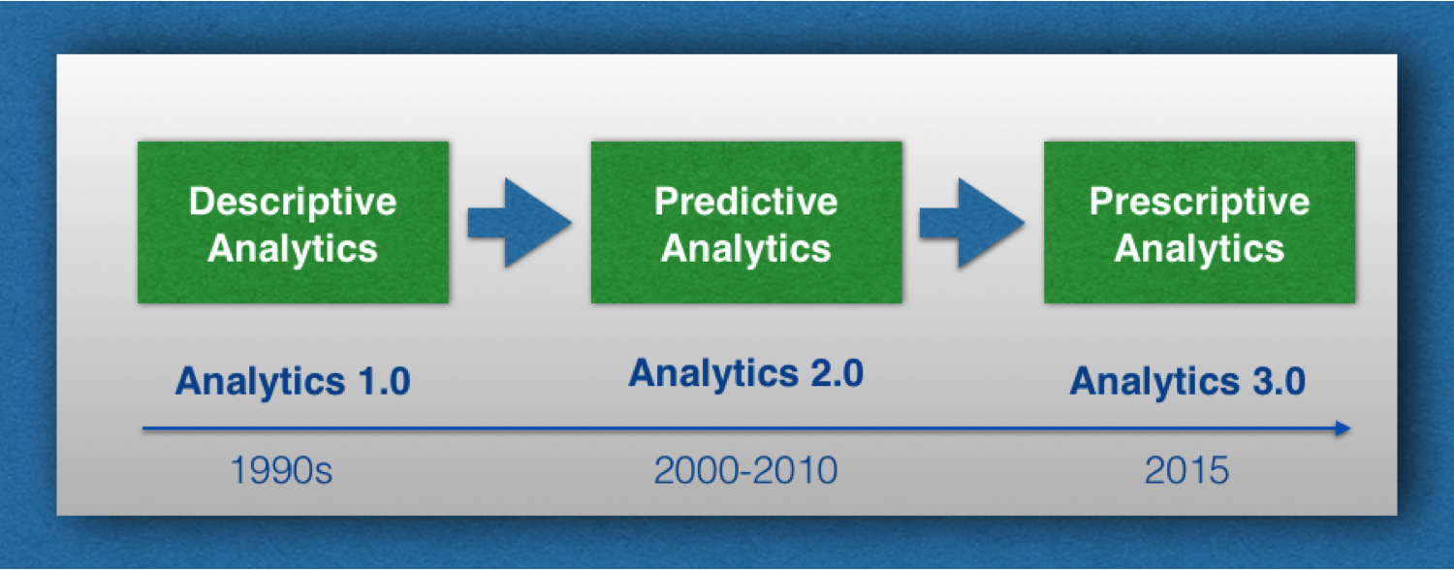

Slide 24
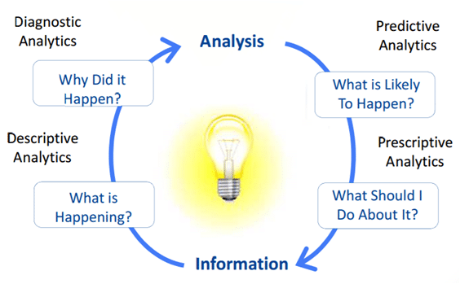
Different Types of Big Data Analytics

Slide 25
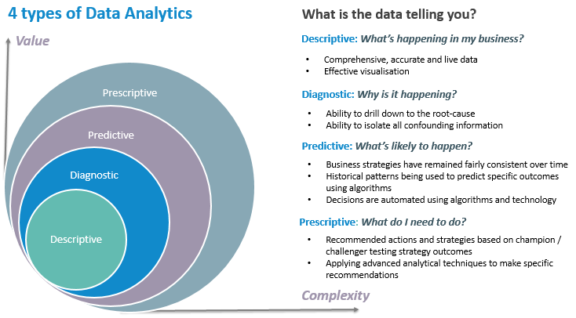

Slide 26
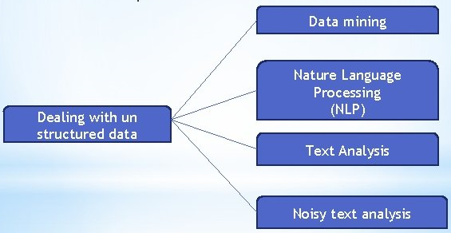
Techniques to deal Unstructured data

Slide 27
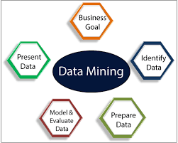
Data Mining
Extracting useful information from large set of data using algorithms & techniques is known as “Data Mining”.
This can be done by finding consistent patterns in large datasets or systematic relationship between used parameters.

Slide 28
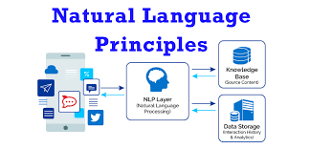
Natural Language Processing (NLP)
It refers to the branch of artificial intelligence with giving computers the ability to understand text and spoken words in much the same way human beings can.

Slide 29
Text Analysis
It aims to extract machine-readable information from unstructured text in order to enable data-driven approaches towards managing content.
Text Analysis is to create structured data out of free or un-structured text content/data.

Slide 30
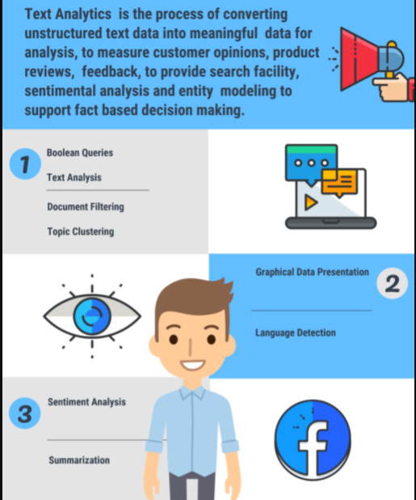
Text Analysis

Slide 31
Noisy Text Analysis
It is process of extracting structured or semi- structured information from noisy unstructured data like chats, blogs, Wikipedia, emails, short message service (SMS).
The noisy unstructured data usually comprises one or more of following:
Spelling mistakes
Abbreviations like: Dr., Prof. Mr.
Acronyms like UGC, AICTE, GLA
Missing characters in word like “um”, “ur”

Slide 32
Data Warehouse
A data warehouse is a type of data management system that is designed to enable and support business intelligence (BI) activities, especially analytics.
Data warehouses are solely intended to perform queries and analysis and often contain large amounts of historical data.
The data within a data warehouse is usually derived from a wide range of sources such as application log files and transaction applications.

Slide 33
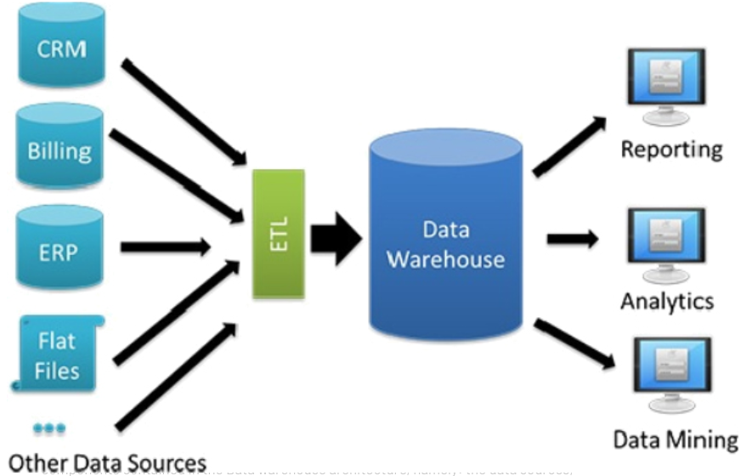

Slide 34
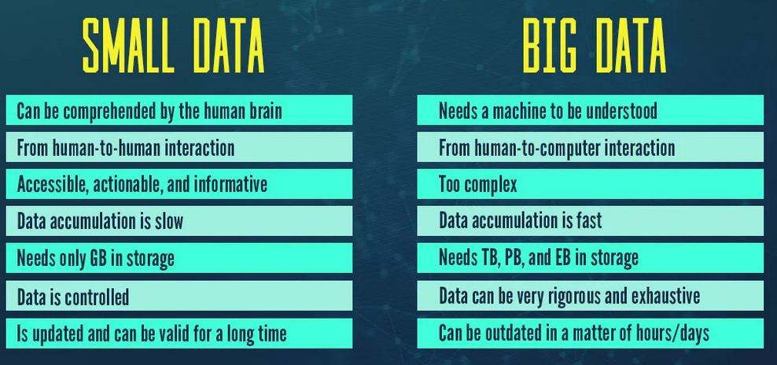
Small Data Vs Big Data

Slide 35
Small Data Vs Big Data
Feature | Small Data | Big Data
Technology | Traditional | Modern
Collection | Generally, it is obtained in an organized manner than is inserted into the database, e.g. table | The Big Data collection is via AWS Kinesis or Google Pub / Sub to balance high-speed data
Volume | Data in the range of tens or hundreds of Gigabytes | Size of Data is more than Terabytes
Analysis Areas | Data marts(Analysts) | Clusters(Data Scientists)
Quality | Contains less noise as data is less collected in a controlled manner | Usually, the quality of data is not guaranteed
Processing | It requires batch-oriented processing pipelines | It has both batch and stream processing pipelines
Database | SQL | NoSQL
Velocity | Constant flow of data, data aggregation is slow | Data arrives at extremely high speeds, large volumes of data aggregation in a short time
Structure | Structured data in tabular with fixed schema(Relational) | Numerous variety of data set including tabular data, text, audio, images, video, logs, JSON etc.(Non Relational)
Scalability | Usually vertically scaled | Usually horizontally scaling architectures

Slide 36
Relational Database (RDBMS)
Schema: A database schema is the skeleton structure that represents the logical view of the entire database.
It defines how the data is organized and how the relations among them are associated.
It can be divided broadly into TWO categories −
Physical Database Schema − This schema pertains to the actual storage of data. For example: files, indices, etc. It defines how the data will be stored in a secondary storage.
Logical Database Schema − This schema defines all the logical constraints that need to be applied on the data stored. It defines tables, views, and integrity constraints.

Slide 37
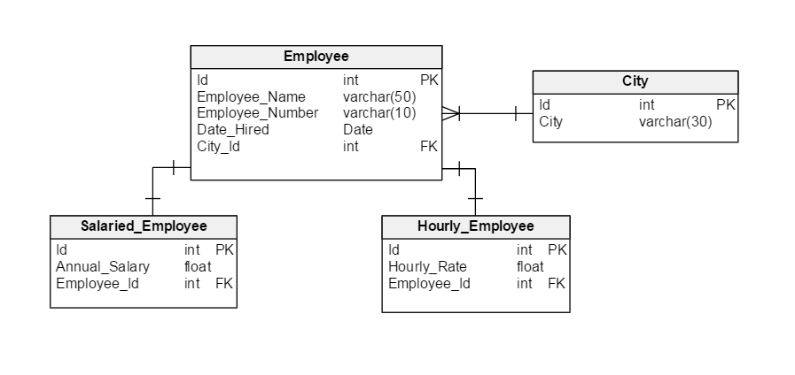
RDBMS Schema

Slide 38
Traditional RDBMS Vs Big Data
S.No | Traditional RDBMS | Big Data
1. | Traditional row-column based databases, basically used for data storage, manipulation and retrieval. | An open-source software used for storing data and running applications or processes concurrently.
2. | structured data is mostly processed. | both structured and unstructured data is processed.
3. | best suited for OLTP environment. | best suited for BIG data.
4. | less scalable than Hadoop. | highly scalable.
5. | Data normalization is required in RDBMS. | Data normalization is not required in Big Data.
6. | Stores transformed and aggregated data. | Stores huge volume of data.
7. | No latency in response. | It has some latency in response.
8. | The data schema of RDBMS is static type. | The data schema is dynamic type.
9. | High data integrity available. | Low data integrity available than RDBMS.
10. | Cost is applicable for licensed software. | Free of cost, as it is an open source software.

Slide 39
Benefits of Big Data Usage
Cost & Management
Economies of scale, “out-sourced” resource management
Reduced Time to deployment
Ease of assembly, works “out of the box”
Scaling
On demand provisioning, co-locate data and compute
Reliability
Massive, redundant, shared resources
Sustainability
Hardware not owned

Slide 40
Terminologies in Big Data Environments
In-Memory Analytics
In-Database Processing
Massively Parallel Processing (MPP)
Symmetric Multiprocessor System (SMP)
Parallel & Distributed System
Shared Nothing Architecture

Slide 41
In-Memory Analytics
Data access from non-volatile storage such as hard disk is a slow process. One way to combat this challenge is to pre-process and store data (cubes, aggregate tables, query sets, etc.) so that the CPU has to fetch a small subset of records. But this requires thinking in advance.
This problem has been addressed using in-memory analytics. Here all the relevant data is stored in RAM.
The advantage is faster access, rapid deployment, better insights, and minimal IT involvement.

Slide 42
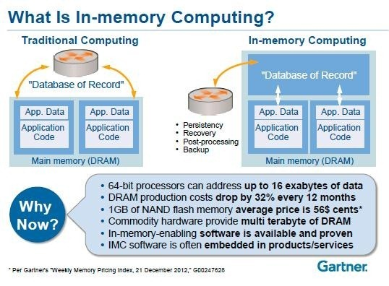

Slide 43
In-Database Processing
In-database processing is also called as in-database analytics. It works by fusing data warehouses with analytical systems.
Typically the data from various enterprise OLTP systems after cleaning up (de-duplication, scrubbing, etc.) through the process of ETL is stored in the Enterprise Data Warehouse (EDW) or data marts.
With in-database processing, the database program itself can run the computations eliminating the need for export and thereby saving on time.

Slide 44
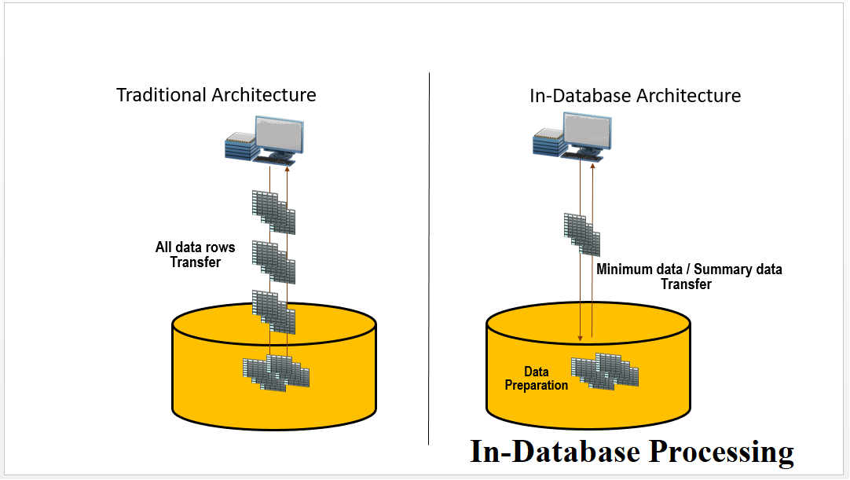

Slide 45
Symmetric Multiprocessor System (SMP)
In SMP, there is a single common main memory that is shared by two or more identical processors.
The processors have full access to all I/O devices and are controlled by a single operating system instance.
SMP are tightly coupled multiprocessor systems.
Each processor has its own high-speed memory, called cache memory and are connected using a system bus.

Slide 46
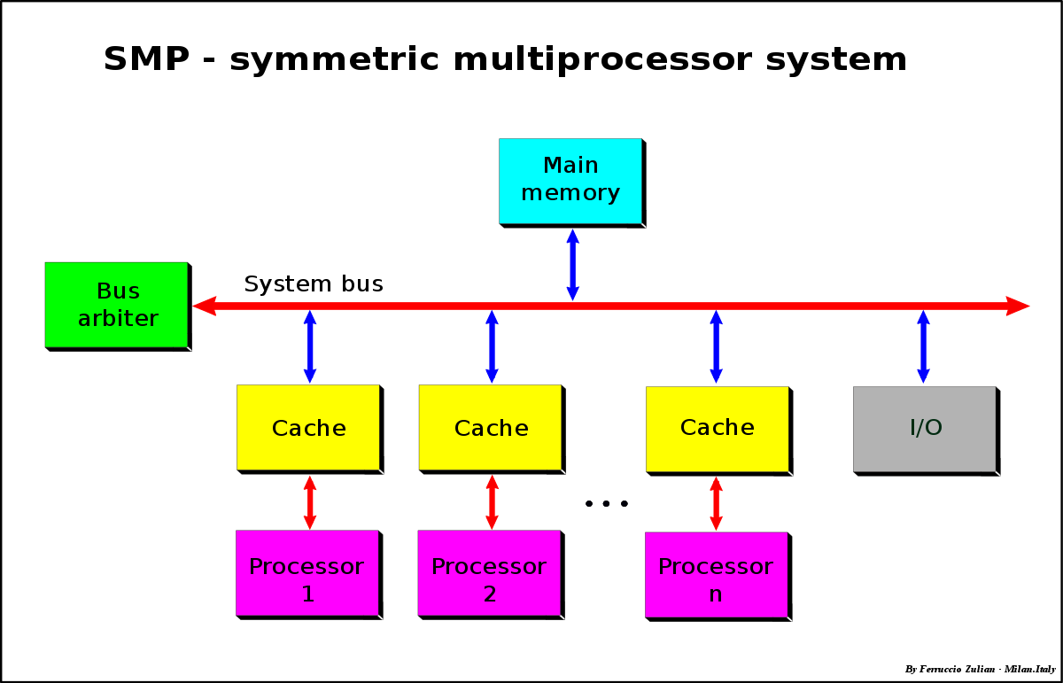

Slide 47
Massively Parallel Processing
MPP refers to the coordinated processing of programs by a number of processors working in parallel fashion.
The processors, each have its own operating systems, dedicated memory & I/O subsytem.
It work on different parts of the same program.
MPP processors communicate using some sort of messaging interface.

Slide 48
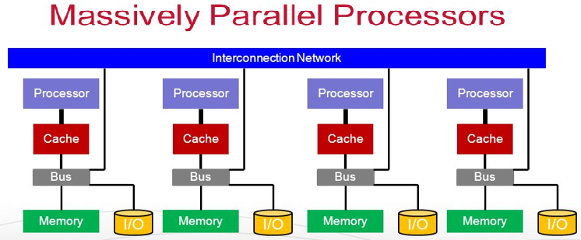

Slide 49
Parallel and Distributed Database System
A parallel database system is a tightly coupled system. The processor co-operate for query processing and user is unaware of such parallelism.
Distributed database systems are known to be loosely coupled and are composed by individual machines. Each of the machines can run their individual application and serve their own respective users. The data is usually distributed across several machines.

Slide 50
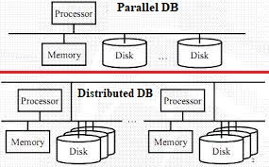
Parallel and Distributed Database (DB) System

Slide 51
Shared Nothing Architecture
In shared nothing architecture, neither memory nor disk have been shared among multiple processors.
Advantages:
Fault Isolation
Scalability

Slide 52
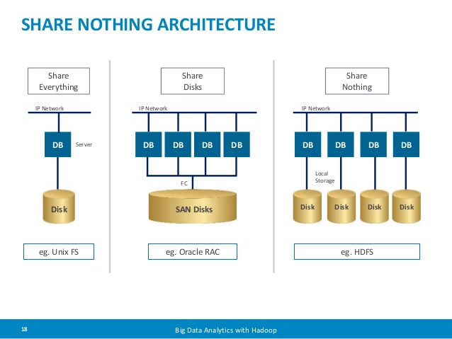

Slide 53
Applications of Big Data
Big Data in the Banking and Securities Industry
Big Data in Communications, Media and Entertainment
Big Data in Healthcare
Big data in Manufacturing
Big data in Retail Trade & E-Commerce Industry

Slide 54
Scalability Concept in Big Data
The scalability can be measured by the number of requests it can effectively support simultaneously.
The limit is reached when a critical hardware resource runs out, requiring different or more machines.
Scaling these resources can include any combination of adjustments to CPU and physical memory, hard disk , and/or the network devices

Slide 55
Type of Scalability
Scaling up: This vertical type of scaling means changing your server with a faster one that has more powerful resources (processors and memory). Also, known as Vertical Scalability.
Scaling out: This horizontal type of scaling means using more servers for parallel computing. Also, known as Horizontal Scalability.

Slide 56
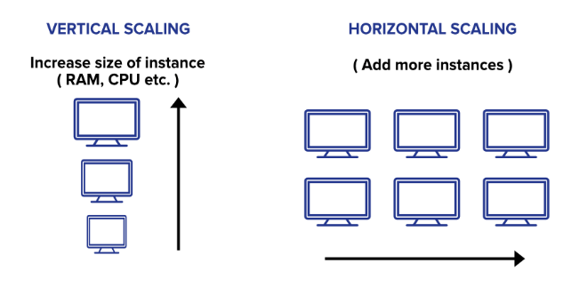

Slide 57
CAP Theorem
In theoretical computer science, the CAP theorem, also named Brewer's theorem after computer scientist Eric Brewer, stated for a distributed data store and stands for:
Consistency: Every read receives the most recent write or an error.
Availability: Every request receives a response, with the guarantee that it contains the most recent write.
Partition Tolerance: The system continues to operate, rather than arbitrary number of messages being dropped (or delayed) by the network between nodes.

Slide 58
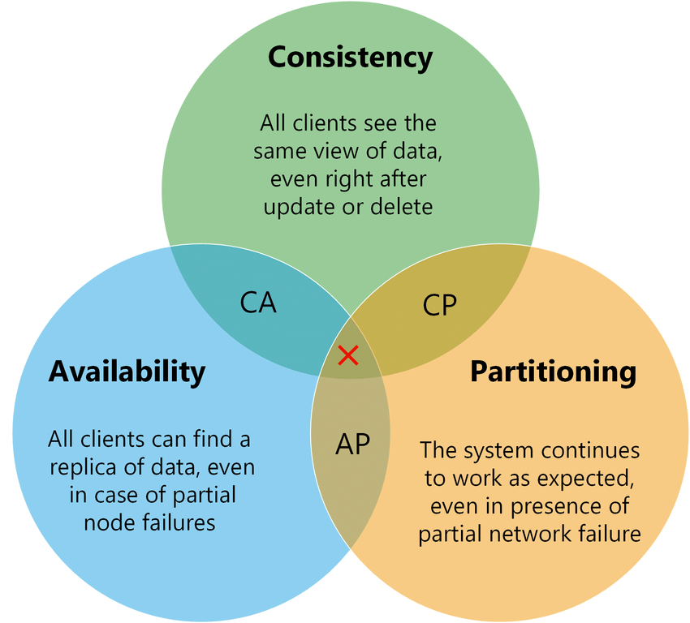

Slide 59
Distributed Computing Environment
In computing, the Distributed Computing Environment (DCE) software system was developed in the early 1990s from the work of the Open Software Foundation (OSF).
Provide Set of tools and services which simply supports the development and operation of distributed applications.
Example: “Middleware” based on client server model.

Slide 60
Distributed Computing Environment
DCE is based on three distributed computing models:
Client/server: A way of organizing a distributed application
Remote procedure call: A way of communicating between parts of a distributed application
Shared files: A way of handling data in a distributed system, based on a personal computer file access model.

Slide 61
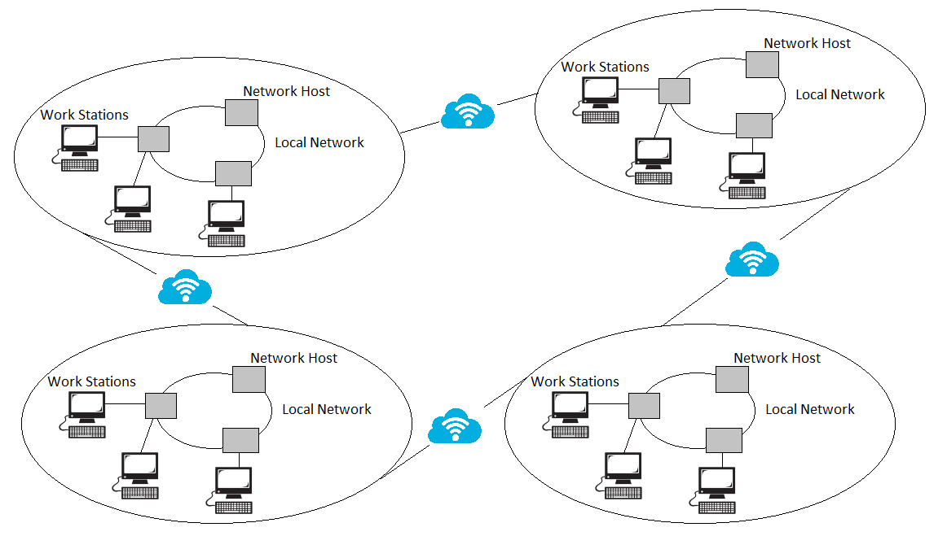
Distributed Computing Environment

Slide 62
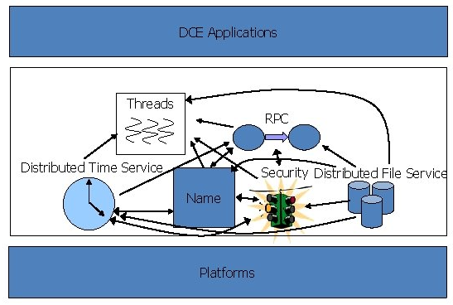

Slide 63
Advantages of Distributed Computing
Reliability, high fault tolerance: A system crash on one server does not affect other servers.
Scalability: In distributed computing systems you can add more machines as needed.
Flexibility: It makes it easy to install, implement and debug new services.
Fast calculation speed: A distributed computer system can have the computing power of multiple computers, making it faster than other systems.
Openness: Since it is an open system, it can be accessed both locally and remotely.
High performance: Compared to centralized computer network clusters, it can provide higher performance and better cost performance.

Slide 64
Disadvantages of Distributed Computing
Difficult troubleshooting: Troubleshooting and diagnostics are more difficult due to distribution across multiple servers.
Less software support: Less software support is a major drawback of distributed computer systems.
High network infrastructure costs: Network basic setup issues, including transmission, high load, and loss of information.
Security issues: The characteristics of open systems make data security and sharing risks in distributed computer systems.

Slide 65
Example of Distributed Computing
Telecommunication Networks like cellular networks & wireless sensor networks
World Wide Web & peer-to-peer networks
Real-Time Process Control: industrial control systems
Parallel Computation like cluster computing, & cloud computing

Slide 66
Jaccard Similarity
The Jaccard index, also known as the Jaccard similarity coefficient, is a statistic used for gauging the similarity and diversity of sample sets. It was developed by Paul Jaccard, originally giving from the French name.

Slide 67
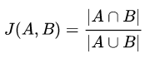
How to Calculate the Jaccard Index
The formula to find the Index is:
Jaccard Index = (the number in both sets) / (the number in either set) * 100
The same formula in notation is:

Slide 68
The Jaccard Distance
The Jaccard distance measures the dissimilarity between two datasets and is calculated as:
Jaccard distance = 1 – Jaccard Similarity

Slide 69
Example
A simple example using set notation: How similar are these two sets?
A = {0,1,2,5,6}
B = {0,2,3,4,5,7,9}
Solution: J(A,B) = |A∩B| / |A∪B| =
=|{0,2,5}| / |{0,1,2,3,4,5,6,7,9}|
= 3/9 = 0.33.
Jaccard Index= 0.33 * 100 = 33

Slide 70
Another Example
E = ['cat', 'dog', 'hippo', 'monkey']
F = ['monkey', 'rhino', 'ostrich', 'salmon']
Number of observations in both, i.e. |E ∩ F|:
= {‘monkey’} = 1
Number of observations in either, i.e. |E ∪ F| : ={‘cat’, ‘dog’, hippo’, ‘monkey’, ‘rhino’, ‘ostrich’, ‘salmon’} = 7
Jaccard Similarity: 1 / 7= 0.142857

Slide 71
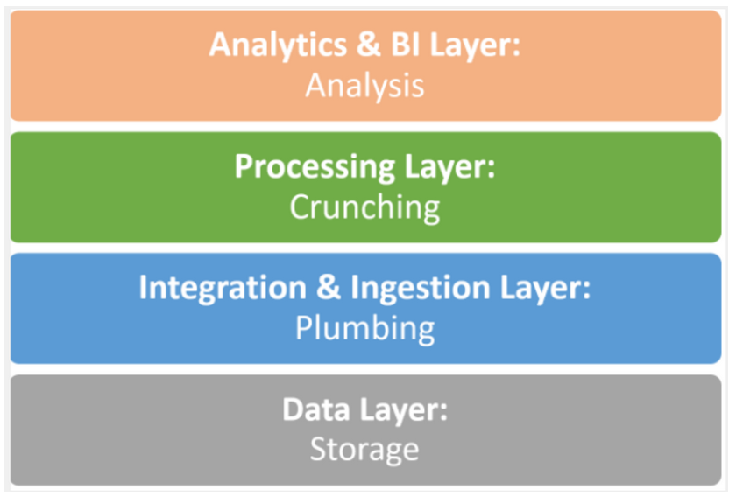
Big Data Stack (Layers)
Organizations support storing, ingesting, processing and analyzing huge quantities of data

Slide 72
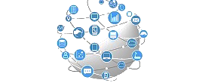
Data Layer (Physical)
Store masses of raw data, which comes from traditional sources.
OLTP databases,
less structured sources like log files, sensors, web analytics, document and media archives.
It is the backend of the entire system

Slide 73
Data Storage Systems
Hadoop HDFS—the classic big data file system. It became popular due to its robustness and limitless scale.
Amazon S3— It is Simple Storage Service (S3) create buckets and load the data using a variety of integrations, with 99.999999999% guaranteed of durability. S3 is simple, secure, and provides a quick and cheap solution for storing limitless amounts of big data.
MongoDB— a mature open source document-based database, built to handle data at scale with proven performance.

Slide 74
Data Ingestion & Integration Layer
To create a big data store, you’ll need to import data from its original sources into the data layer.
Data Ingestion is the process of transportation of data from assorted sources to a storage medium where it can be accessed, used, and analyzed by an organization.

Slide 75
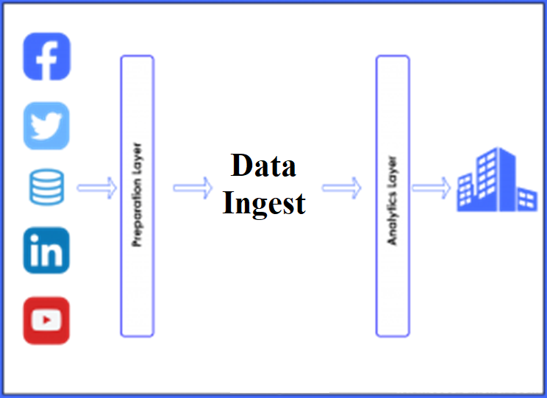
You can leverage a rich ecosystem of big data integration tools, including powerful open source integration tools, to pull data from sources, transform it, and load it to a target system of your choice

Slide 76
Big Data Integration Tools
Stitch — lightweight ETL (Extract, Transform, Load) tool which pulls data from multiple pre-integrated data.
Blendo— A Cloud data integration tool that lets you connect data sources with a few clicks, and pipe all data to Amazon Redshift, PostgreSQL, or MS SQL Server.
Apache Kafka — an open source streaming messaging bus that can creates a feed from your data sources, partitions the data, and streams it to a passive listener.

Slide 77
Data Processing Layer
It is most important layer in the end to end Big Data technology stack.
A analyst process large volume of data into relevant data marts which finally goes to the presentation layer.
It is a layer where data is needed for analysis is selected, cleaned, formatted for further analysis and modelling.

Slide 78
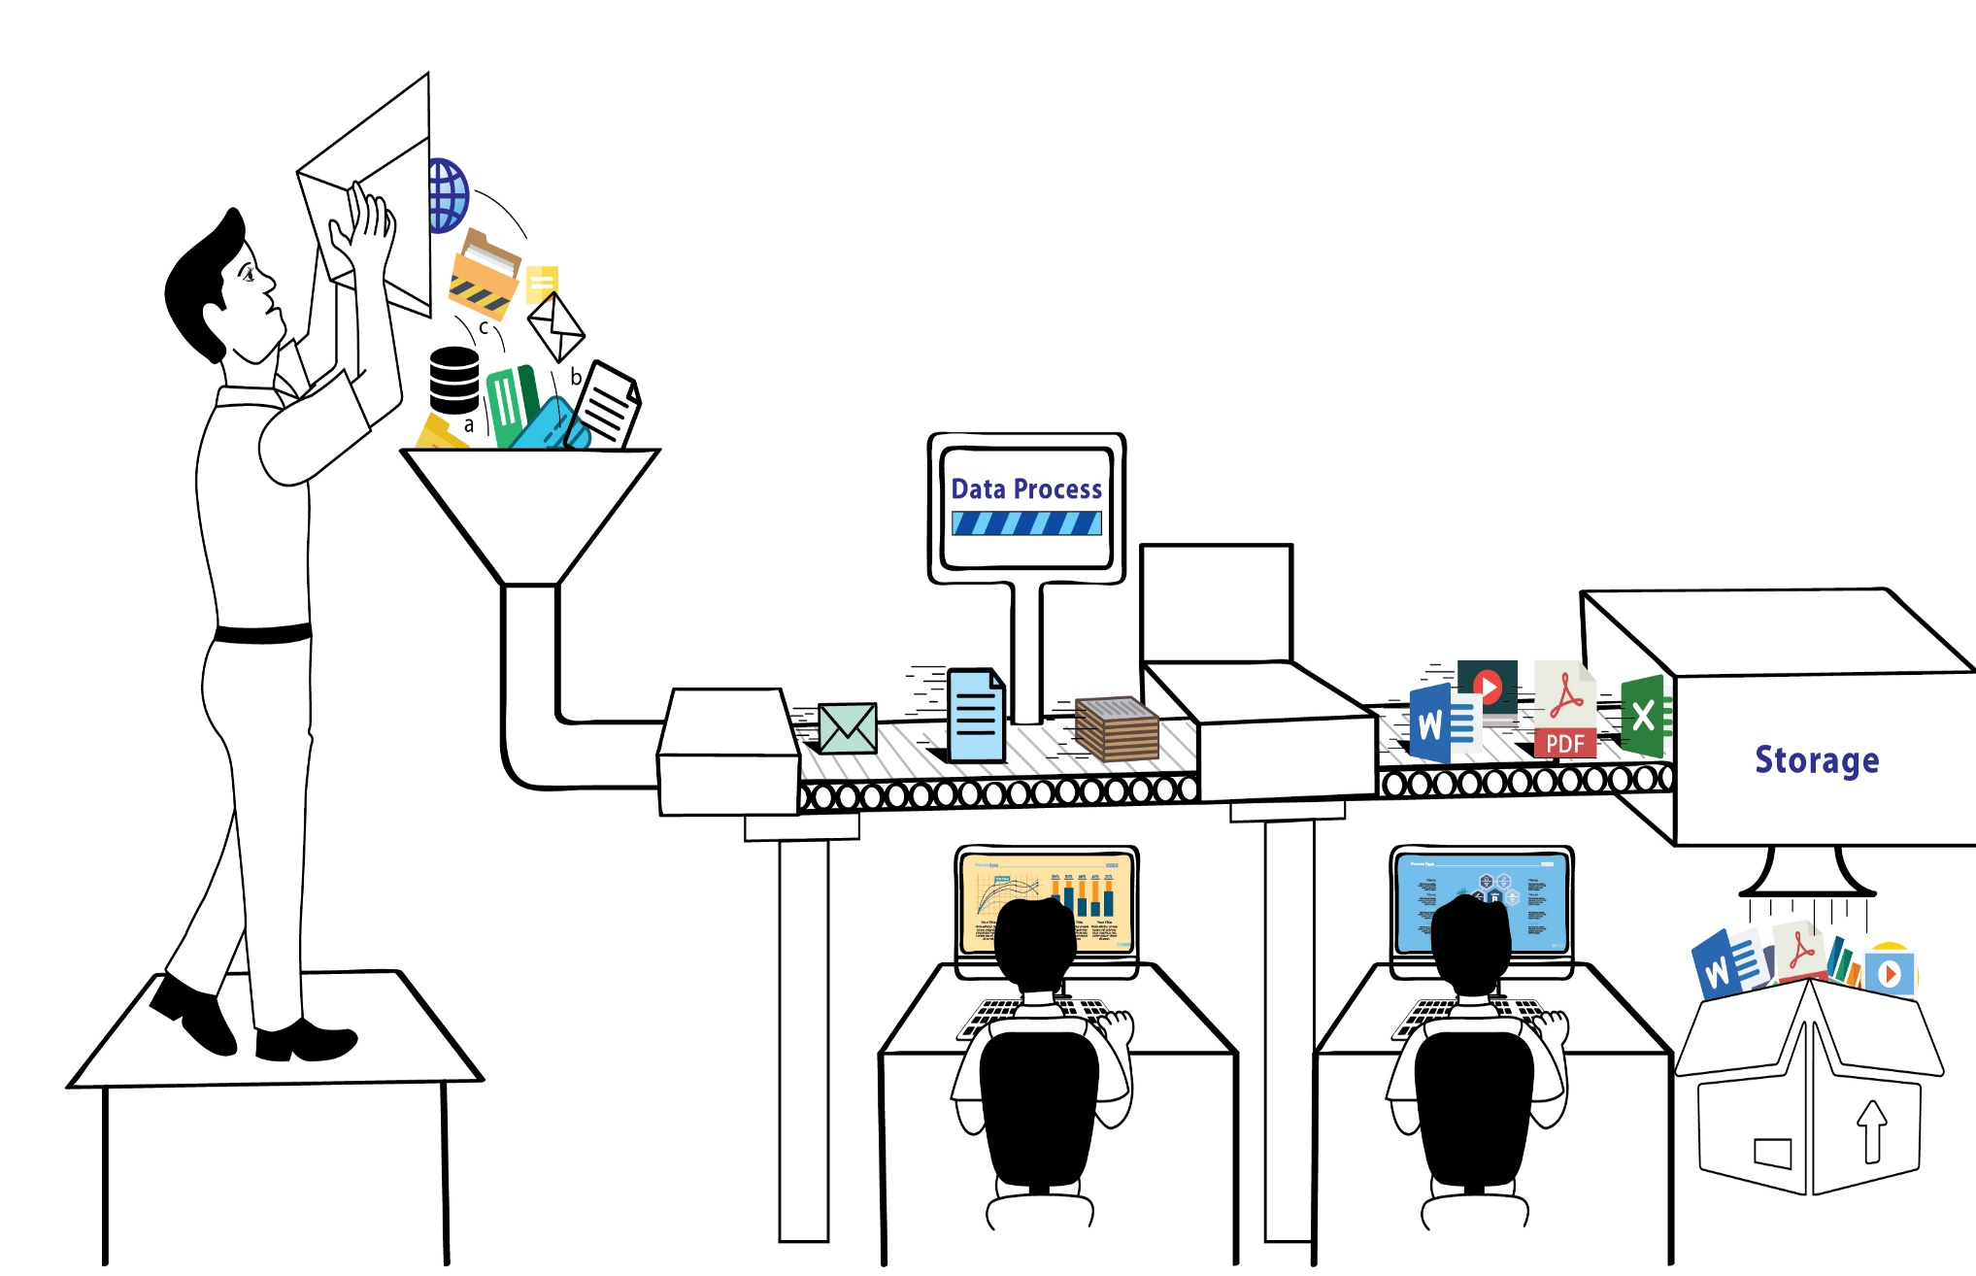

Slide 79
Data Processing Tools
Apache Spark—like the old Map/Reduce but over 100X faster. Runs parallelized queries on unstructured, distributed data in Hadoop, Mesos, & Kubernetes.
PostgreSQL—many organizations pipe their data to good old Postgres to facilitate queries.
Amazon Redshift—a cloud-based data warehouse offering blazing query speeds that can be used as a relational database.

Slide 80
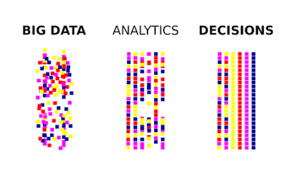

Slide 81

Analytics & BI Layer (Presentation)
It is the topmost layer in the technology stack which is where the actual analysis & insight generation happens

Slide 82
BI Tools
Tableau—powerful BI and data visualization tool, which connects to your data and allows you to drill down, perform complex analysis, and build charts and dashboards.
Chartio—cloud BI service allowing you to connect data sources, explore data and create live auto-refreshing dashboards.
Looker —cloud-based BI platform that lets you query and analyze large data sets.

Slide 83
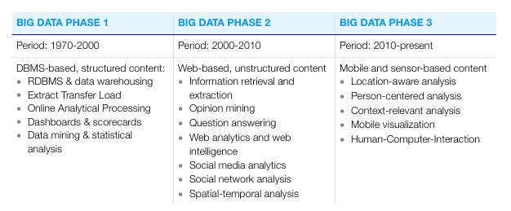
Big Data 1.0, Big Data 2.0 & Big Data 3.0

Slide 84
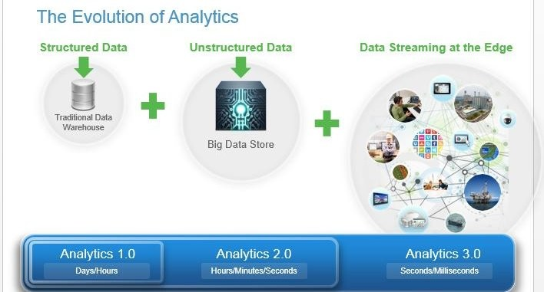

Slide 85
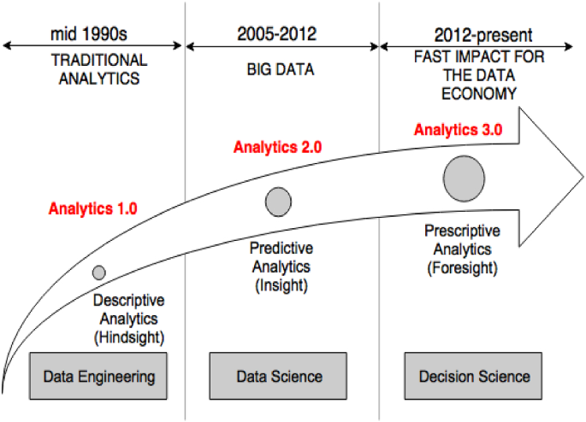

Slide 86
Traditional BI vs. Big Data Environment
Business Intelligence (BI) is the collection of systems, software, and products, which can import large data streams and use them to generate meaningful information.
Big Data is the most buzzing word in the business. It is not a just massive amount of data, it is also about processing the data with the purpose of delivering added value to the organization.

Slide 87
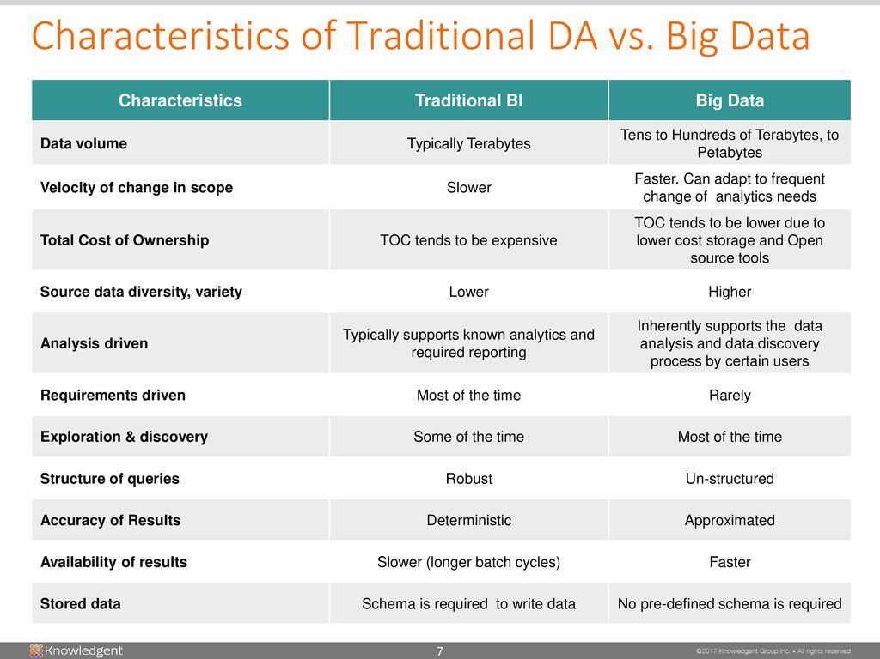

Slide 88
OLAP & OLTP
Within the data science field, there are two types of data processing systems:
Online Analytical Processing (OLAP) and
Online Transaction Processing (OLTP).
The main difference is that one uses data to gain valuable insights, while the other is purely operational………. IBM Definition

Slide 89
OLAP
Online analytical processing (OLAP) is a system for performing multi-dimensional analysis at high speeds on large volumes of data.
Typically, this data is from a data warehouse, data mart or some other centralized data store.
OLAP is ideal for data mining, business intelligence and complex analytical calculations,

Slide 90
OLTP
Online transactional processing (OLTP) enables the real-time execution of large numbers of database transactions by large numbers of people, typically over the Internet.
OLTP systems are behind many of our everyday transactions, from ATMs to in-store purchases to hotel reservations.
OLTP can also drive non-financial transactions, including password changes and text messages.
OLTP systems use a relational database

Slide 91
NoSQL Databases
A originally referring to "non-SQL" or "non-relational” database
NoSQL relies upon a softer model known as the BASE model. BASE (Basically Available, Soft state, Eventual consistency).
Such databases have existed since the late 1960s, but the name "NoSQL" was only coined in the late 2000s century as the cost of storage dramatically decreased.
NoSQL databases are increasingly used in big data and real-time web applications.
NoSQL systems are also sometimes called "Not only SQL"

Slide 92
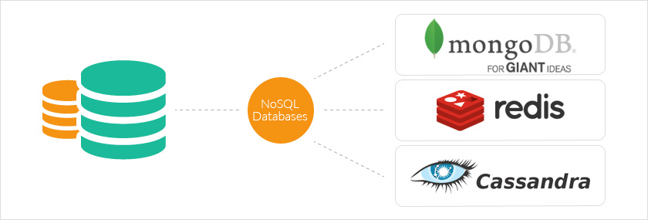

Slide 93
Characteristics of NoSQL
Schema free
Eventually consistent (as in the BASE property)
Replication of data stores to avoid Single Point of Failure.
Can handle Data variety and huge amounts of data.

Slide 94
NoSQL databases fall into four main categories
Key-value databases are a simpler type of database where each item contains keys and values.
Wide-column stores store data in tables, rows, and dynamic columns.
Document databases store data in documents similar to JSON (JavaScript Object Notation) objects. Each document contains pairs of fields and values.
Graph databases store data in nodes and edges. Nodes typically store information about people, places, and things, while edges store information about the relationships between the nodes.

Slide 95
NoSQL databases - Example
Key value Stores — Riak, Voldemort, and Redis
Wide Column Stores — Cassandra and HBase.
Document databases — MongoDB
Graph databases — Neo4J and HyperGraphDB.

Slide 96
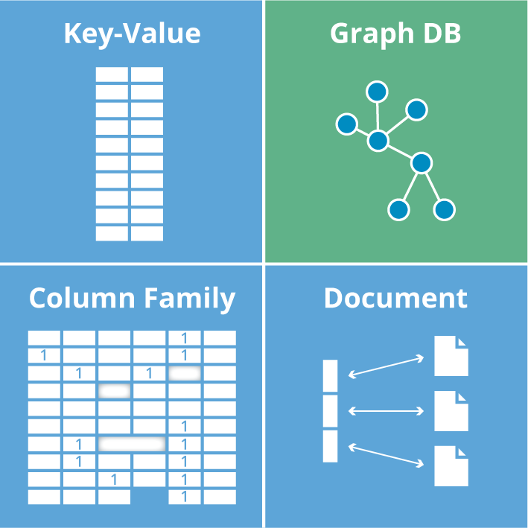
Type of NoSQL Database

Slide 97
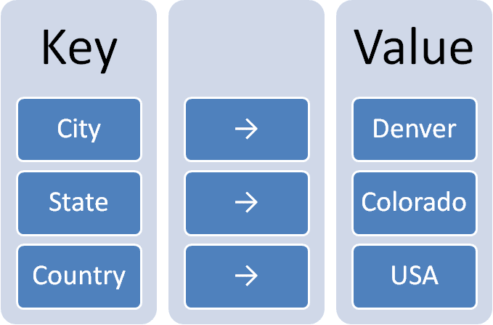
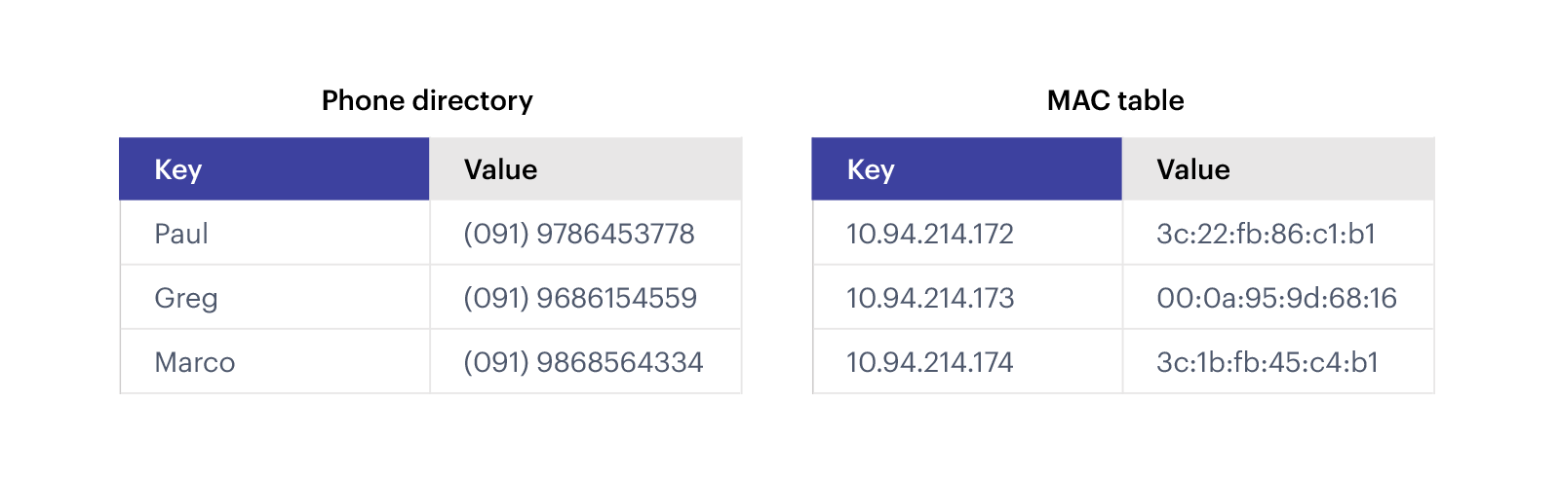
Key Value Databases

Slide 98

Column Family Databases

Slide 99
Document Databases
Document stores uses JSON, XML, or BSON (binary encoding of JSON) documents to store data.
It is like a key-value database, but a document store consists of semi-structured data.
A single document is to store records and its data

Slide 100


Slide 101
Graph databases
Graph database requires only storing data once (nodes). The different types of relationships (edges) are specified to the stored data.
The relationships between the nodes are predetermined.
Traversing persisted relationships are faster.

Slide 102



Slide 103
Advantages of NoSQL
Cost-effectiveness: it allow quickly scale horizontally, better allocating resources to minimize costs.
Flexibility: can address large volumes of rapidly changing data, making them great for agile development.
Replication: provides data reliability, ensuring access during down time and protecting against data loss if servers go offline.
Speed: enables faster, more agile storage and processing for all users,

Slide 104

NoSQL Vs. RDBMS

Slide 105

SQL & NoSQL

Slide 106


It is a class of RDBMS that seek to provide the scalability of NoSQL systems for online transaction processing (OLTP) workloads
Also guarantees the ACID properties of a traditional database system.

Slide 107

NewSQL compare with NoSQL & SQL

Slide 108

Data Science
Data science is an interdisciplinary field that uses scientific methods, processes, algorithms and systems to extract knowledge and insights from noisy, structured and unstructured data.
Apply knowledge and actionable insights from data across a broad range of application domains.

Slide 109


Slide 110

Components of Data Science

Slide 111
Responsibilities of a Data Scientist
To first discover the actual problem and then analyze it in such a way that it can benefit the organization to the fullest.
To gather a large amount of raw data from discrete sources.
To clean the large datasets and validate it to ensure greater accuracy of the results.
Finding different patterns, values, and relationships in the data.
Finally presenting the findings and results of the complete process through data visualization and various other means.

Slide 112

Data Science Life Cycle

Slide 113

What is Hadoop?
Apache top level project, open-source implementation of frameworks for reliable, scalable, distributed computing and data storage.
It is a flexible and highly-available architecture for large scale computation and data processing on a network of commodity hardware.

Slide 114
Framework Vs Library
Library : It performs a set of specific and well-defined operations. Examples : Network protocols, compression, image manipulation, string utilities, regular expression evaluation, math etc
Framework: It is known to be a skeleton where the application defines the content of the operation by filling out the skeleton. Examples of frameworks: Web application system, Plug-in manager, GUI system. The framework only defines the concept but an application further defines the functionality that is useful for end-users.

Slide 115

Inversion of control: When we call a method from a library, we are in control. But in framework, the control is inverted i.e. the framework calls us.

Slide 116

Apache Hadoop
Apache Hadoop is a framework that allows for the distributed processing of large data sets across clusters of computers using simple programming models.
It is designed to scale up from single servers to thousands of machines, each offering local computation and storage.
Rather than rely on hardware to deliver high-availability, the library itself is designed to detect and handle failures at the application layer, so delivering a highly-available service on top of a cluster of computers, each of which may be prone to failures.

Slide 117


Slide 118


Slide 119


Hadoop Can do:-
Process large & complex datasets effectively.
Work with structure & un-structure data.
Max/Min Size is 128MB data in each cluster of Node.

Slide 120


Google Search Engines
1998
2022

Slide 121





Hadoop’s Developers
2005: Doug Cutting & Michael J. Cafarella developed Hadoop to support distribution for the Nutch search engine project.
The project was funded by Yahoo.
2006: Yahoo gave the project to Apache
Software Foundation.
Doug Cutting
Michael J. Cafarella

Slide 122






Hadoop Origins
2003
2004
2006

Slide 123

Some Hadoop Milestones
2008 - Hadoop Wins Terabyte Sort Benchmark (sorted 1 terabyte of data in 209 seconds, compared to previous record of 297 seconds)
2009 - Avro and Chukwa became new members of Hadoop Framework family
2010 - Hadoop's Hbase, Hive and Pig subprojects completed, adding more computational power to Hadoop framework
2011 - ZooKeeper Completed
2013 - Hadoop 1.1.2 and Hadoop 2.0.3 alpha.
- Ambari, Cassandra, Mahout have been added

Slide 124
HDFS Facts
In 2010, Facebook claimed to have one of the largest HDFS cluster storing 21 Petabytes of data.
In 2012, Facebook declared that they have the largest single HDFS cluster with more than 100 PB of data.
And Yahoo! has more than 100,000 CPU in over 40,000 servers running Hadoop, with its biggest Hadoop cluster running 4,500 nodes. All told, Yahoo! stores 455 petabytes of data in HDFS.
In fact, by 2013, most of the big names in the Fortune 50 started using Hadoop.

Slide 125
Distributed File System
Distributed File System talks about managing data, i.e. files or folders across multiple computers or servers.
DFS is a file system that allows us to store data over multiple nodes or machines in a cluster and allows multiple users to access data.
Even though the files are stored across the network,
DFS organizes, and displays data in such a manner that a user sitting on a machine will feel like all the data is stored in that very machine.

Slide 126
HDFS (HADOOP DISTRIBUTED FILE SYSTEM)
1. Storage component of Hadoop.
2. Distributed File System.
3. Modeled after Google File System.
4. Optimized for high throughput (HDFS leverages large block size and moves computation where data is stored).
5. You can replicate a file for a configured number of times, which is tolerant in terms of both software and hardware.
6. Re-replicates data blocks automatically on nodes that have failed.
7. You can realize the power of HDFS when you perform read or write on large files (gigabytes and larger).
8. Sits on top of native file system such as ext3 and ext4, which is described

Slide 127
Why Hadoop
Its capability to handle massive amount of data, different categories of data – fairly & quickly.
Low Cost
Computing Power
Scalability
Storage Flexibility
Inheritance Data Protection.

Slide 128
Hadoop Framework
IBM Definition
Apache Hadoop is an open source software framework that provides highly reliable distributed processing of large data sets using simple programming models.
Hadoop, known for its scalability, is built on clusters of commodity computers, providing a cost-effective solution for storing and processing massive amounts of structured, semi-structured and unstructured data with no format requirements.
It provides a software framework for distributed storage and processing of big data using the MapReduce programming model.

Slide 129
Hadoop Core Concept
The base Apache Hadoop framework is composed of the following modules:
Hadoop Distributed File System (HDFS) – a distributed file-system that stores data on commodity machines, providing very high aggregate bandwidth across the cluster.
Hadoop YARN – (introduced in 2012) a platform responsible for managing computing resources in clusters and using them for scheduling users' applications.
Hadoop MapReduce – an implementation of the MapReduce programming model for large-scale data processing.
Hadoop Common (others) – contains libraries and utilities needed by other Hadoop modules.

Slide 130


Slide 131

Hadoop Core Components

Slide 132

Hadoop Core Components

Slide 133
Hadoop Architecture
The Hadoop architecture is a package of the file system, MapReduce engine and the HDFS (Hadoop Distributed File System). The MapReduce engine can be MapReduce/MR1 or YARN/MR2.
A Hadoop cluster consists of a single master and multiple slave nodes. The master node includes Job Tracker, Task Tracker, NameNode, and DataNode whereas the slave node includes DataNode and TaskTracker.

Slide 134


Slide 135

Hadoop Conceptual Layer
Hadoop High Level Architecture

Slide 136


Slide 137

HDFS
It is Hadoop Distributed File System which is utilized for storage permission is a Hadoop cluster.
HDFS provides Fault-tolerance and High availability to the storage layer.

Slide 138
Hadoop Cluster
Hadoop cluster is also a collection of various commodity hardware(devices that are inexpensive and amply available). This Hardware components work together as a single unit.
We design Hadoop clusters for storing, analyzing, understanding, and for finding the facts that are hidden behind the data or datasets which contain some crucial information.

Slide 139


Slide 140
Nodes in HDFS
There are two types of nodes in hadoop:- Name Node and Data Node. It is called as a “node“ as all these computers are interconnected. NameNode is also known as the Master node.
A node in hadoop simply means a computer that can be used for processing and storing.
Master node in hadoop, is responsible for storing data in HDFS and executing parallel computation of stored data using MapReduce.
Master Node has 3 nodes – NameNode, Secondary NameNode and JobTracker.
Slave nodes in Hadoop, is stored and where data processing takes place.

Slide 141
HDFS Daemons
NameNode:
Single NameNode per cluster.
DataNode:
Multiple DataNode per cluster
Read/Write operations
SecondaryNameNode:
Housekeeping Daemon

Slide 142
Master Node
NameNode: It is the master Daemon in Hadoop HDFS. It maintains the filesystem namespace. It stores metadata about each block of the files.
ResourceManager: It is the master daemon of YARN. It arbitrates resources amongst all the applications running in the cluster.

Slide 143
Slave Node
DataNode: DataNode is the slave node/daemon of Hadoop HDFS. It runs on slave machines. It stores actual data or blocks.
NodeManager: It is the slave node/daemon of YARN. It takes care of all the individual computing nodes in the cluster.
NodeManager: Coordinates the resources for an individual slave node and reports back to the Resource Manager.

Slide 144
MapReduce
MapReduce nothing but just like an Algorithm or a data structure that is based on the YARN framework.
The major feature of MapReduce is to perform the distributed processing in parallel in a Hadoop cluster.
In first phase, Map is utilized and in next phase Reduce is utilized.

Slide 145

MapReduce
The Map() function here breaks this DataBlocks into Tuples which is a “key-value pair”.
The Reduce() function then combines this broken Tuples or key-value pair to desired OUTPUT.

Slide 146

What is MapReduce Programming?
MapReduce Programming is a software framework. MapReduce Programming helps you to process massive amounts of data in parallel.

Slide 147
How MapReduce Works
MapReduce are two functions:
Map and Reduce.
It has sequenced one after the other.
The Map function takes input from the disk as <key,value> pairs, processes them, and produces another set of intermediate <key,value> pairs as output.
The Reduce function also takes inputs as <key,value> pairs, and produces <key,value> pairs as output.

Slide 148


Slide 149

How MapReduce Works

Slide 150

MapReduce Daemons
Job Tracker Task Tracker

Slide 151
JobTracker
It process runs on a separate node and not usually on a DataNode.
It is an essential Program/Daemon for MapReduce.
It receives the requests for MapReduce execution from the client.
It talks to the NameNode to determine the location of the data.
When the JobTracker is down, HDFS will still be functional but the MapReduce execution can not be started and the existing MapReduce jobs will be halted.

Slide 152
TaskTracker
It runs on DataNode. Mostly on all DataNodes.
Mapper and Reducer tasks are executed on DataNodes administered by TaskTrackers.
TaskTrackers will be assigned Mapper and Reducer tasks to execute by JobTracker.
TaskTracker will be in constant communication with the JobTracker signalling the progress of the task in execution.
TaskTracker failure is not considered fatal. When a TaskTracker becomes unresponsive, JobTracker will assign the task executed by the TaskTracker to another node.
It is replaced by “NodeManager” in Mapreduce Version 2 (MRv2).

Slide 153
Yet Another Resource Negotiator (YARN)
YARN performs 2 operations:- Job scheduling and Resource Management.
Purpose of Job schedular is to divide a big task into small jobs so that each job can be assigned to various slaves in a Hadoop cluster and Processing can be Maximized.
Job Scheduler also keeps track of which job is important, which job has more priority, dependencies between the jobs and all the other information like job timing, etc.
Resource Manager is to manage all the resources that are made available for running a Hadoop cluster.

Slide 154

Yet Another Resource Negotiator (YARN)

Slide 155

YARN Daemons
Resource Manager Node Manager

Slide 156
Features of YARN
Multi-Tenancy
Scalability
Cluster-Utilization
Compatibility

Slide 157
Advantages of Hadoop
Fast: In HDFS, the data distributed over the cluster and are mapped which helps in faster retrieval.
Scalable: Hadoop cluster can be extended by just adding nodes in the cluster.
Cost Effective: Hadoop is open source and uses commodity hardware to store data.
Resilient to failure: HDFS has the property with which it can replicate data over the network.

Slide 158
How Hadoop Works ?
Hadoop stores and processes the data in a distributed manner across the cluster of commodity hardware.
To store and process any data, the client submits the data and program to the Hadoop cluster.
Hadoop HDFS stores the data, MapReduce processes the data stored in HDFS, and YARN divides the tasks and assigns resources.

Slide 159

How Hadoop Works ?

Slide 160


Slide 161


Replication Management

Slide 162
Difference in Hadoop Versions

Slide 163


Slide 164


Slide 165


